Slide 1

Business Data Management
Capstone Project
Presented by - Vaibhav Kesharwani (21F1003147)

Slide 2
Analyzing the overall performance of Paper Tiger
Stationery shop to increase profitability

Slide 3
Background of the Business
Paper Tiger shop was established in September 2019.
It is located at Satna, Madhya Pradesh, India.
They sell stationery items of all kinds.
They purchase the items from a wholesaler.
They keep their stock in the shop as well as in a godown.

Slide 4
How the data was collected?
After approaching the business owner, I understood the problem of profit that they are facing in their business.
At first, they were reluctant to provide the sales data. I assured them that their shop name would not be disclosed and showed them the BDM Auth Letter, they got some confidence and allowed me to visit their shop to collect data from their notebook of sales records. The data was unstructured so I noted the approximate sales of each item.
Letter from organization

Slide 5
Analysis steps and tools
For preprocessing and analyzing the data, MS Excel has been used.
For deriving descriptive statistics of Revenue per month such as min and max, Pandas python library has been used.
After preprocessing the primary data, the Revenue Pareto chart per item for each month has been created, to analyze what items are sold most or what items are sold less on each month.
The Monthly Total Revenue Pareto chart has been created to analyze on which month the sales are high or low.

Slide 6
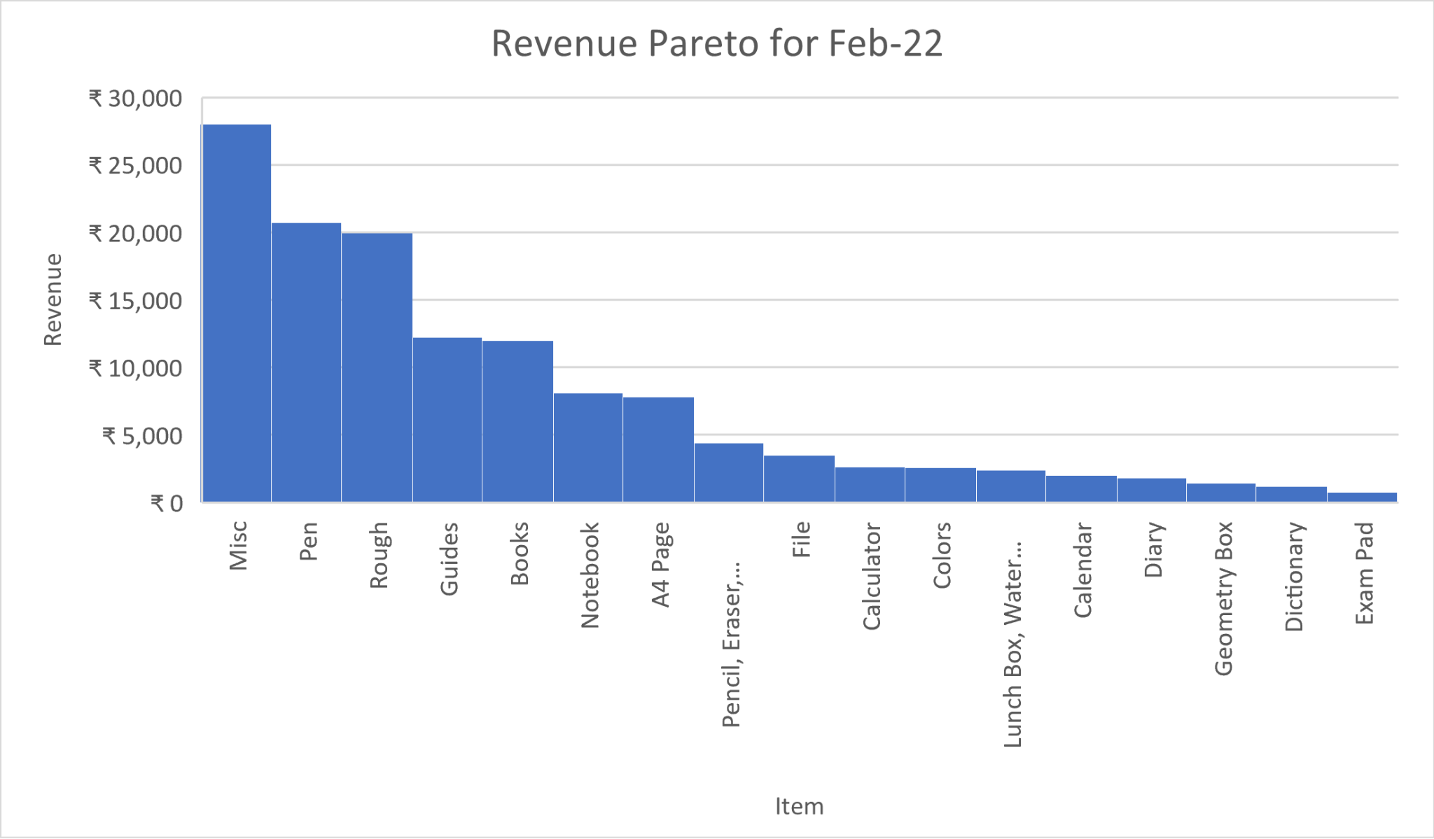
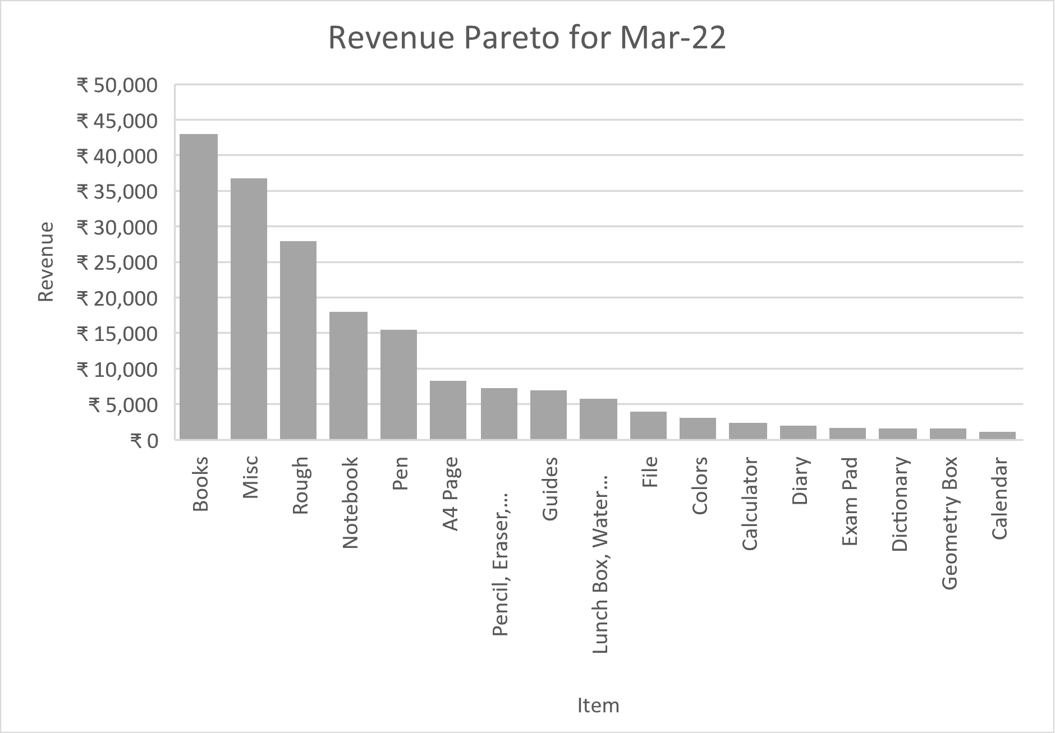
Interpretation of results

Slide 7
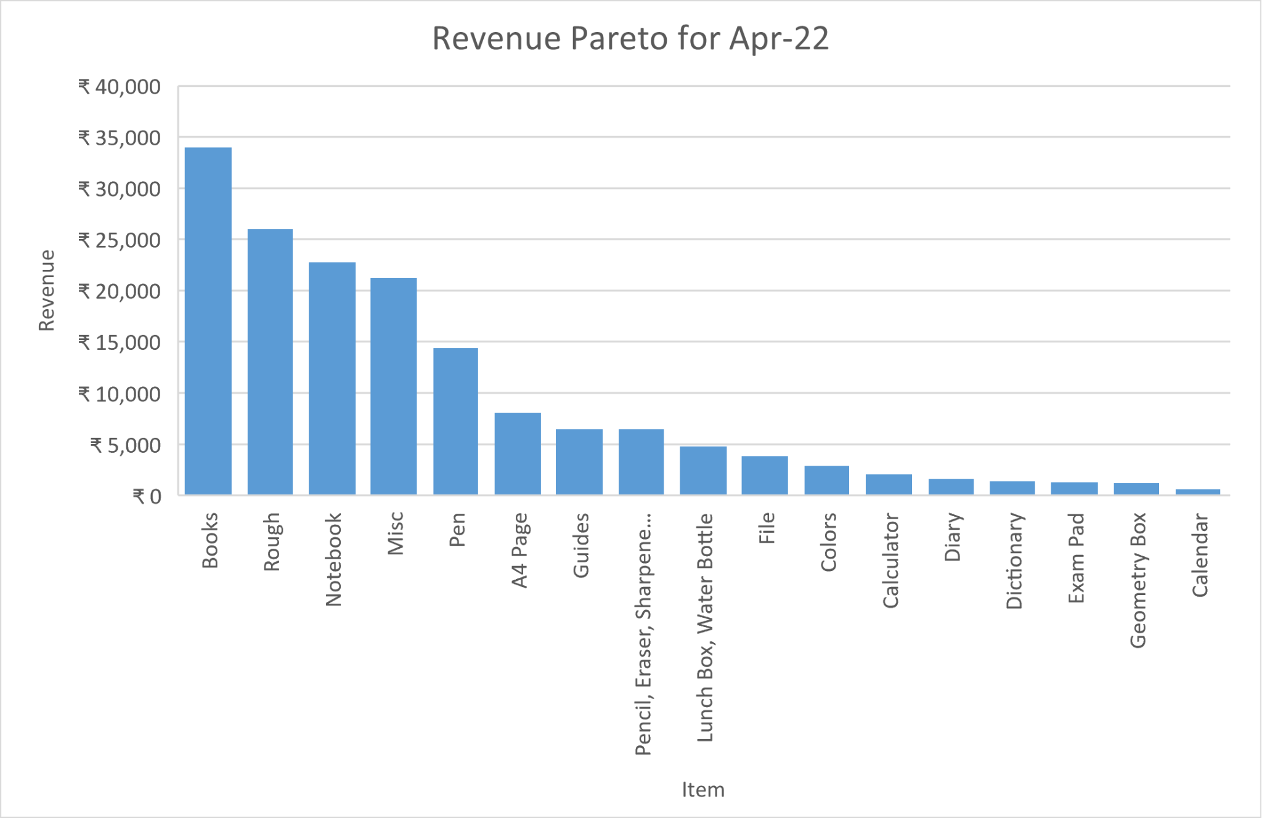
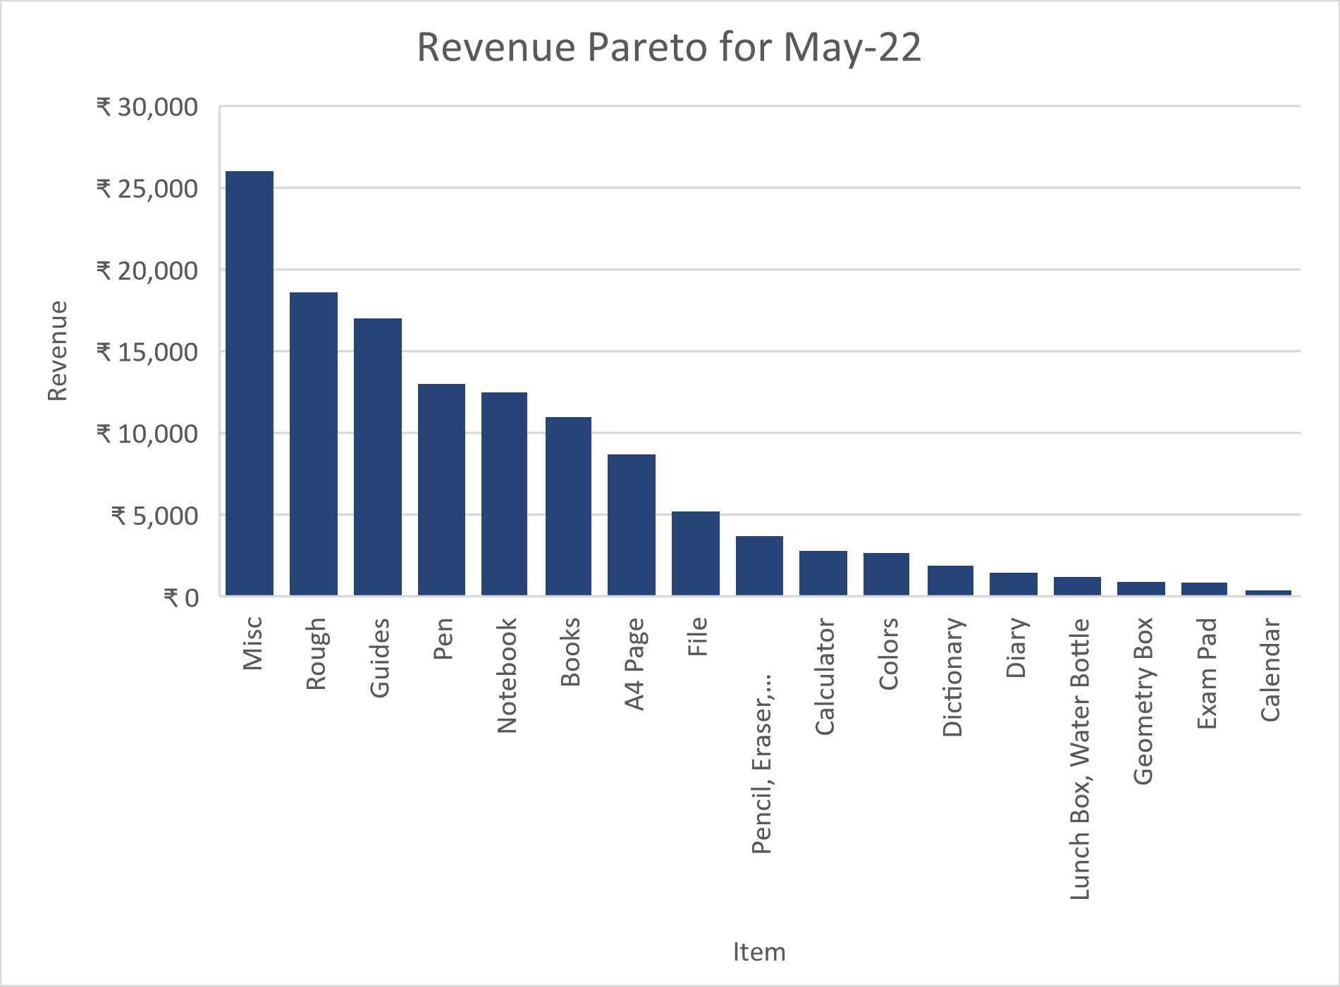
Interpretation of results (contd.)

Slide 8
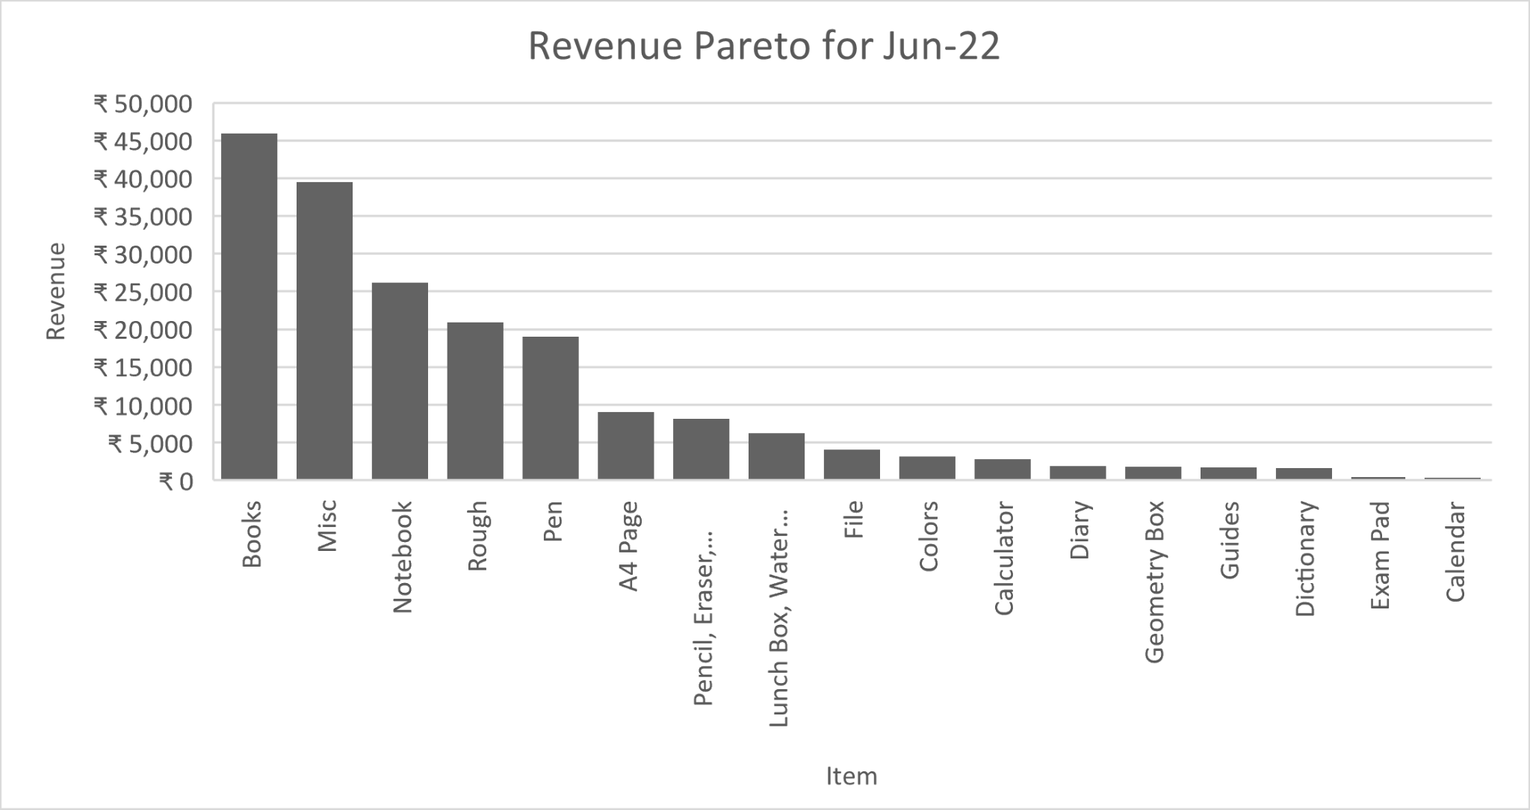
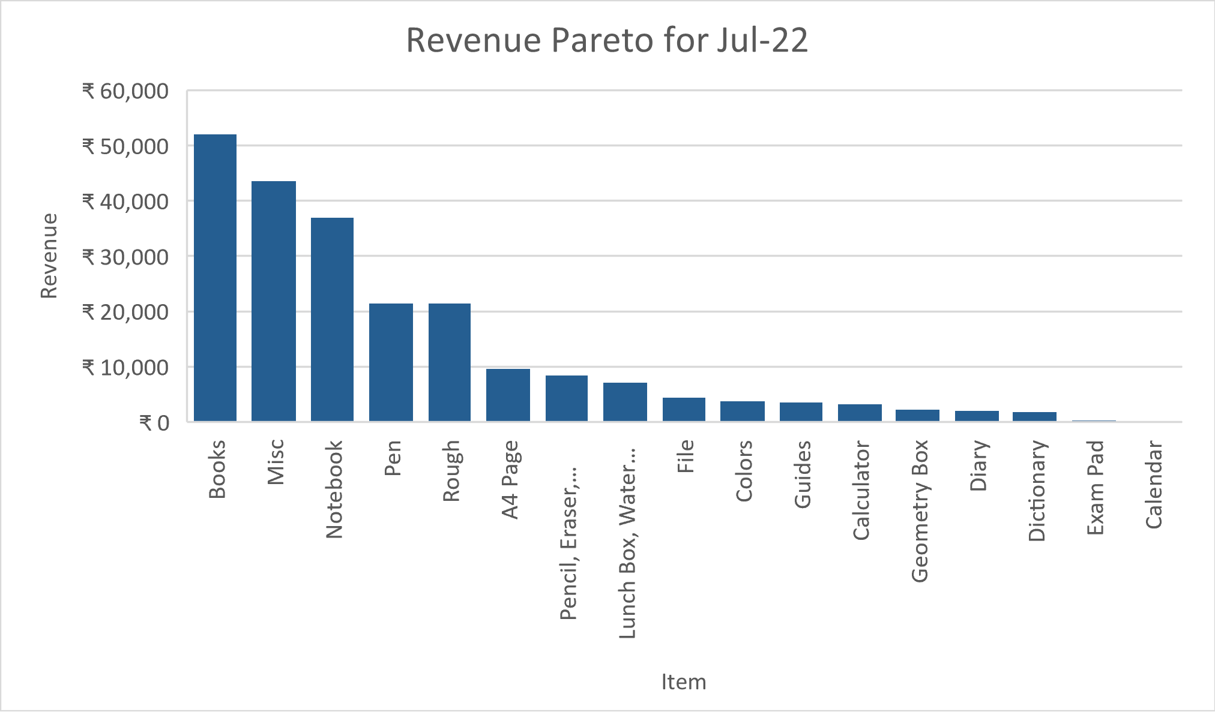
Interpretation of results (contd.)

Slide 9
Interpretation of results (contd.)
After analyzing the data and looking at the Revenue Pareto charts per item for each month, it has been found out that the Books are sold the most for 4 months (Mar, Apr, Jun and Jul) out of 6 months (Feb, Mar, Apr, May, Jun, Jul).
Leaving the ‘Misc’ category aside, the second and third most items that have been
selling the highest are Rough and Notebooks.
It has been observed that the Books, Rough, and Notebooks are contributing to the sales
the most. As a result, these items have been the major source of income for this business.

Slide 10
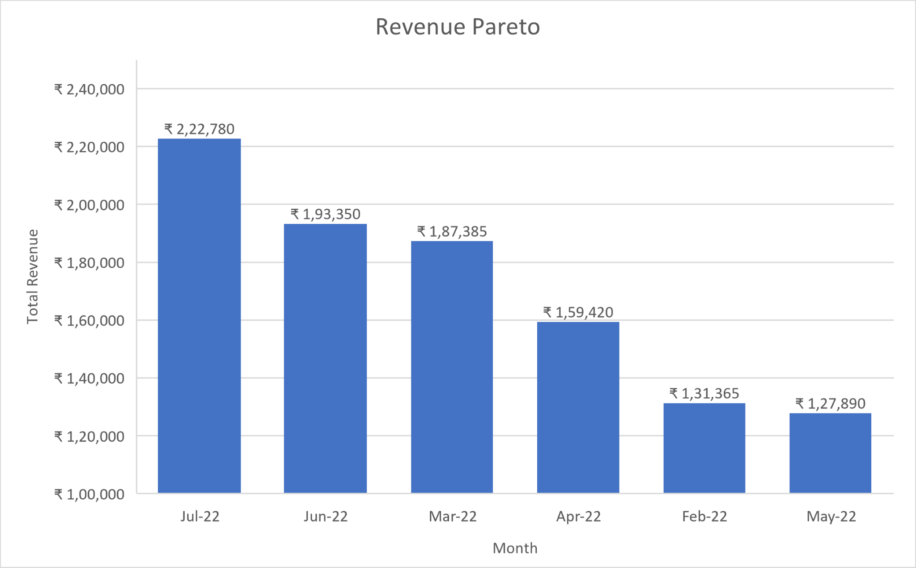
Interpretation of results (contd.)
Revenue per month Pareto

Slide 11
Interpretation of results (contd.)
After looking at the Total Revenue per month Pareto chart, it has been observed that the highest Revenue is generated in July, out of 6 months. This has been happening maybe because as the new sessions of Schools and Colleges are opened, students might want to buy Books, Rough, Notebooks, Pen, etc., which are the major source of income as observed from the charts.
Looking at the monthly expenses of the shop, It has been concluded that the fixed expense of Rs. 9500/month cannot be decreased.

Slide 12
Recommendations
The highest Revenue items such as Books, Rough and Notebooks should be bought in bulk for the month of July, to get the items at a low cost. As a result, the profit margin would be increased.
As Students tend to buy more stationery in the months of June and July, the business owner should reach out to more schools and try to tie up with more schools.

